Slide 1
PREDICTING THE CARAVAN INSURANCE POLICY USER’S
TEAM – DATA NINJAS

Slide 2
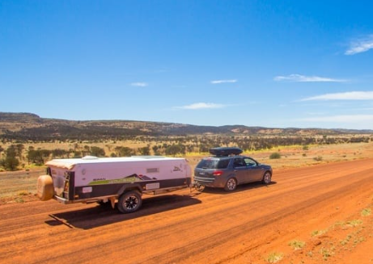
CARAVAN

Slide 3
TEAM MEMBERS:
PAVAN PABBA
REVANTH MANDADI
GAYATHRI KASTURI
SUNIL GANGUPAMU
LAVANYA PEDDIREDDY
HARI KRISHNA AGEER

Slide 4

AGENDA :
Business Context and Solution
​Advantages
​Dataset Exploration
Data Cleaning and Model Fitting
Comparison of Results
Conclusion
Future Scope

Slide 5
Business Problems:
Insurance Companies are spending insane amount on customer acquisition in various ways/systems.
Targeting wrong customers repeatedly could damage company reputation.
We can resolve this by a predictive modelling, If the Company would know more precisely whom to target. This targeted approach aims to optimize our Customer Acquisition Cost (CAC) by allocating resources to prospects most likely to convert.

Slide 6
Advantages to Business:
Optimal Marketing and Sales Strategies
Customized Policy Recommendations
Companies will get more returns as they can predict their clients.
Competitive Advantage

Slide 7
Data Exploration:
Data Set : Insurance Company Benchmark (COIL 2000)
Link to Data Set: https://archive.ics.uci.edu/dataset/125/insurance+company+benchmark+coil+2000 . Author: Peter Putten
This data consists about customers consists of 86 variables and includes product usage data and socio-demographic data derived from zip area codes. The training set contains over 5000 descriptions of customers, including the information of whether they have a caravan insurance policy. A test set contains 4000 customers of whom only the organizers know if they have a caravan insurance policy.

Slide 8
Features and Targets :
Here in this data set we have three files.
TICDATA2000.txt: Dataset to train and validate prediction models and build a description (5822 customer records). Each record consists of 86 attributes, containing sociodemographic data (attribute 1-43) and product ownership (attributes 44-86). The sociodemographic data is derived from zip codes. All customers living in areas with the same zip code have the same sociodemographic attributes. Attribute 86, "CARAVAN: Number” of mobile home policies", is the target variable.
TICEVAL2000.txt: Dataset for predictions (4000 customer records). It has the same format as TICDATA2000.txt, only the target is missing. Participants are supposed to return the list of predicted targets only. All datasets are in tab delimited format.

Slide 9
Data Preprocessing :
Identifying Missing Values
Imputing Values
Checking Column names
Addressing the Data Imbalance (SMOTE).
Feature Selection based on Correlation

Slide 10
Model Fitting :
Selecting the Model
Split the data into Trian and Test
Data Scaling
Fit the Model
Model prediction by Metrics Used
Model Scoring

Slide 11

Prediction Process:
Collect the Data
Clean the Data
Split the data
Train the data
Scaling the data
Fitting the models
Predicting “Yes” or “No” in Target Variable

Slide 12
Models Used for Prediction:
Decision Tree
Random Forest
XG Boost
Gradient Boost
SVC

Slide 13
Models Comparison :
Model | Recall | AUC
Decision Tree | 0.92 | 0.91
Random Forest | 0.955 | 0.988
XG Boost | 0.953 | 0.98
Gradient Boost | 0.94 | 0.96
SVM | 0.94 | 0.98

Slide 14
Models Comparison :
On Comparing all the models, We came to conclusion that Random Forest is the best model by using “Recall” metrics.
My primary goal is to maximize recall (identifying customers who will buy caravan insurance), then the Random Forest model with hyperparameters obtained from Grid Search seems to be the best choice, as it has the highest recall among all models. Additionally, the Random Forest model also has a high AUC (0.988), indicating good overall performance in terms of distinguishing between positive and negative cases.

Slide 15
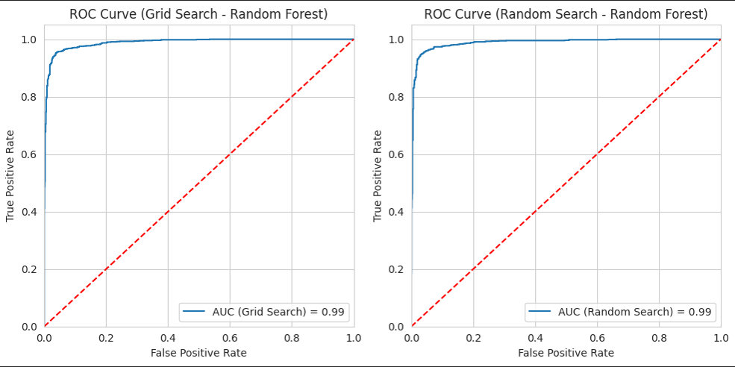
Random Forest ROC Curve :

Slide 16
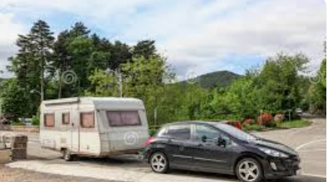

Conclusion ??

Slide 17
Conclusion :
Metrics Used
Why we Choose “Recall” as metric ?
A high recall means that the model is good at identifying most of the relevant instances of the class it's supposed to detect.
It suggests that the model has a low rate of false negatives, meaning it rarely misses positive cases.
We got Recall as 0.956 for our Random Forest Model.

Slide 18

Future Scope:
Tailor Insurance Policies to Individuals
Marketing Strategies can be improved
These kind of predictive models can be used in different types of Insurances as well.

Slide 19

Thank You…

Slide 20

Any Questions or Suggestions?

